Slide 1
Module 4: Secure Device Access
Networking Security v1.0
(NETSEC)
Notes:
Networking Security (NETSEC) Module 4: Secure Device Access

Slide 2
Module Objectives
Module Title: Secure Device Access
Module Objective: Configure secure administrative devices.
Topic Title | Topic Objective
Securing the Edge Router | Explain how to secure a network perimeter.
Configure Secure Administrative Access | Use the correct commands to configure passwords on a Cisco IOS device.
Configure Enhanced Security for Virtual Logins | Use the correct commands to configure enhanced security for virtual logins.
Configure SSH | Configure an SSH daemon for secure remote management.
Notes:
2
4 – Secure Device Access
4.0.2 – What will I learn to do in this module?

Slide 3
4.1 Secure the Edge Router
Notes:
4: Secure Device Access 4.1: Secure the Edge Router

Slide 4
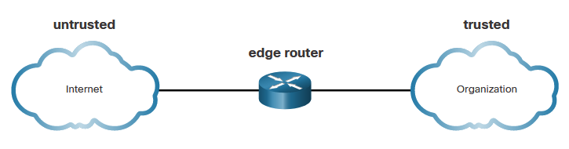
Secure the Edge Router
Secure the Network Infrastructure
Securing the network infrastructure is critical to overall network security. The network infrastructure includes routers, switches, servers, endpoints, and other devices. Routers are a primary target for attacks because these devices direct traffic into, out of, and between networks.
The edge router shown in the figure is the last router between the internal network and an untrusted network, such as the internet. All an organization’s internet traffic goes through an edge router, which often functions as the first and last line of defense for a network.
Notes:
4: Secure Device Access 4.1: Secure the Edge Router 4.1.1: Secure the Network Infrastructure

Slide 5
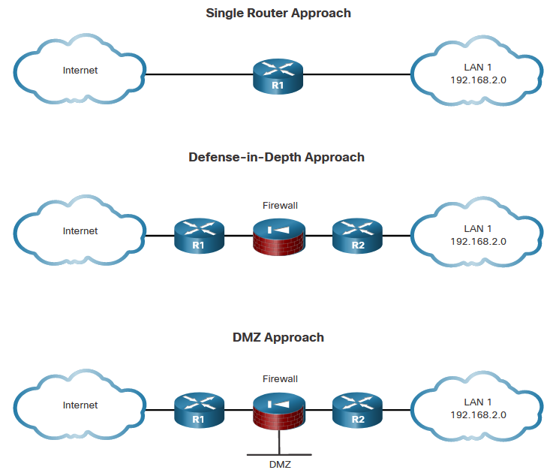
Secure the Edge Router
Edge Router Security Approaches
Single Router - A single router connects the protected network or internal local area network (LAN), to the internet. All security policies are configured on this device.
Defense-in-Depth – This uses multiple layers of security prior to traffic entering the protected LAN. There are three primary layers of defense: the edge router, the firewall, and an internal router that connects to the protected LAN.
DMZ - The DMZ can be used for servers that must be accessible from the internet or another external network. The DMZ can be set up between two routers, with an internal router connecting to the protected network and an external router connecting to the unprotected network.
Notes:
4: Secure Device Access 4.1: Secure the Edge Router 4.1.2: Edge Router Security Approaches

Slide 6
Secure the Edge Router
Three Areas of Router Security
Three areas of router security must be maintained:
Physical - Place the router and physical devices that connect to it in a secure locked room that is accessible only to authorized personnel. Install an uninterruptible power supply (UPS) or diesel backup power generator.
Operating System - Configure the router with the maximum amount of memory possible. The availability of memory can help mitigate DoS attacks. Use the latest, stable version of the operating system that meets the feature specifications of the router or network device. Keep a secure copy of router operating system images and router configuration files as backups.
Router Hardening - Ensure that only authorized personnel have access and that their level of access is controlled. Disable unused ports and interfaces. Disable unnecessary services. A router has services that are enabled by default. Some of these services can be used by an attacker to gather information about the router and the network.
Notes:
4: Secure Device Access 4.1: Secure the Edge Router 4.1.3: Three Areas of Router Security

Slide 7
Secure the Edge Router
Secure Administrative Access
Securing administrative access is important. If an unauthorized person gains administrative access to a router, that person could alter routing parameters, disable routing functions, or discover and gain access to other systems within the network. Several tasks are involved in securing administrative access to an infrastructure device:
Restrict device accessibility
Log and account for all access
Authenticate access
Authorize actions
Present legal notification
Ensure the confidentiality of data
Notes:
4: Secure Device Access 4.1: Secure the Edge Router 4.1.4: Secure Administrative Access

Slide 8
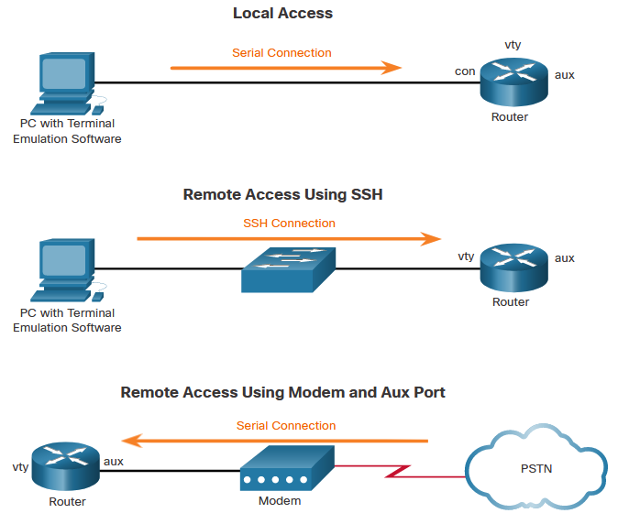
Secure the Edge Router
Secure Local and Remote Access
A router can be accessed for administrative purposes locally or remotely:
Local access - The administrator must have physical access to the router and use a console cable to connect to the console port. Local access is typically used for initial configuration of the device.
Remote access - Although the aux port option is available, the most common remote access method involves allowing Telnet, SSH, HTTP, HTTPS, or SNMP connections to the router from a computer. The computer can be on the local network or a remote network.
Notes:
4: Secure Device Access 4.1: Secure the Edge Router 4.1.5: Secure Local and Remote Access

Slide 9
4.2 Configure Secure Administrative Access
Notes:
4: Secure Device Access 4.2: Configure Secure Administrative Access

Slide 10
Configure Secure Administrative Access
Passwords
The table shows examples of strong and weak passwords.
Weak Password | Why it is Weak
secret | Simple dictionary password
smith | Maiden name of mother
toyota | Make of a car
bob1967 | Name and birthday of the user
Blueleaf23 | Simple words and numbers
Strong Password | Why it is Strong
b67n42d39c | Combines alphanumeric characters
12^h u4@1p7 | Combines alphanumeric characters, symbols, and includes a space
Notes:
4: Secure Device Access 4.2: Configure Secure Administrative Access 4.2.1: Passwords

Slide 11
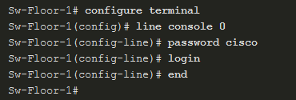

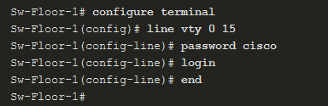
Configure Secure Administrative Access
Configure Passwords
To secure user EXEC mode access, enter line console configuration mode using the line console 0 global configuration command. Specify the user EXEC mode password using the password password command. Enable user EXEC access using the login command.
To have administrator access to all IOS commands including configuring a device, you must gain privileged EXEC mode access. To secure privileged EXEC access, use the enable secret password global config command.
To secure vty lines, enter line vty mode using the line vty 0 15 global config command. Specify the vty password using the password password command. Enable vty access using the login command.
Notes:
4: Secure Device Access 4.2: Configure Secure Administrative Access 4.2.2: Configure Passwords

Slide 12

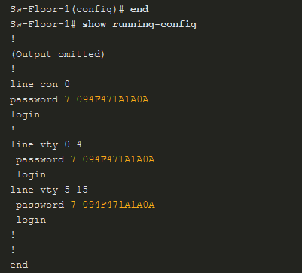
Configure Secure Administrative Access
Encrypt Passwords
Strong passwords are only useful if they are secret. There are several steps that can be taken to help ensure that passwords remain secret on a Cisco router and switch including these:
Encrypting all plaintext passwords
Setting a minimum acceptable password length
Deterring brute-force password guessing attacks
Disabling an inactive privileged EXEC mode access after a specified amount of time.
.
To encrypt all plaintext passwords, use the service password-encryption global config command.
Use the show running-config command to verify that passwords are now encrypted.
Notes:
4: Secure Device Access 4.2: Configure Secure Administrative Access 4.2.3: Encrypt Passwords

Slide 13
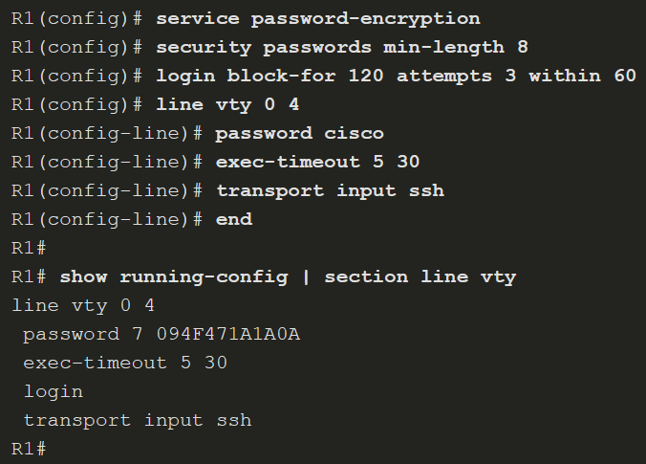
Configure Secure Administrative Access
Additional Password Security
As shown in the sample configuration, the service password-encryption global configuration command prevents unauthorized individuals from viewing plaintext passwords in the configuration file.
To ensure that all configured passwords are a minimum of a specified length, use the security passwords min-length length command in global configuration mode.
Threat actors may use password cracking software to conduct a brute-force attack on a network device. This attack continuously attempts to guess the valid passwords until one works. Use the login block-for seconds attempts number within seconds global configuration command to deter this type of attack.
Notes:
4: Secure Device Access 4.2: Configure Secure Administrative Access 4.2.4: Additional Password Security

Slide 14
Configure Secure Administrative Access
Secret Password Algorithms
MD5 hashes are no longer considered secure because attackers can reconstruct valid certificates. This can allow attackers to spoof any website. The enable secret password uses an MD5 hash by default. It is now recommended that you configure all secret passwords using either type 8 or type 9 passwords. Type 8 and type 9 were introduced in Cisco IOS 15.3(3)M. Type 8 and type 9 use SHA encryption.
To enter an unencrypted password, use the enable algorithm-type command syntax:
Algorithm Keyword | Description
md5 | Type 5; selects the message digest algorithm 5 (MD5) as the hashing algorithm.
scrypt | Type 9; selects scrypt as the hashing algorithm.
sha256 | Type 8: selects Password-Based Key Derivation Function 2 (PBKDF2) with Secure Hash Algorithm, 256-bits (SHA-256) as the hashing algorithm.
Notes:
4: Secure Device Access 4.2: Configure Secure Administrative Access 4.2.5: Secret Password Algorithms
4.2.6: Syntax Checker – Secure Administrative Access on R2

Slide 15
4.3 Configure Enhanced Security for Virtual Logins
Notes:
4: Secure Device Access 4.3: Configure Enhanced Security for Virtual Logins

Slide 16
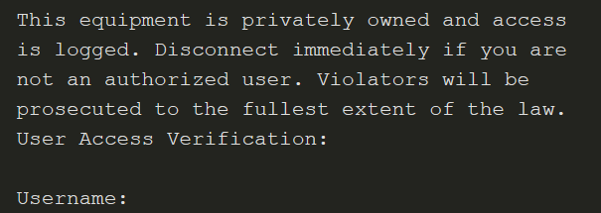
Configure Enhanced Security for Virtual Logins
Enhance the Login Process
Login blocking is enabling a detection profile that lets you configure a network device to react to repeated failed login attempts by refusing further connection requests.
Access control lists (ACLs) can be used to permit legitimate connections from addresses of known system administrators.
Use the banner global configuration mode command to specify appropriate messages. Banners protect the organization from a legal perspective.
Notes:
4: Secure Device Access 4.3: Configure Enhanced Security for Virtual Logins 4.3.1: Enhance the Login Process

Slide 17
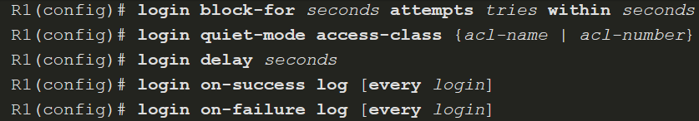
Configure Enhanced Security for Virtual Logins
Configure Login Enhancement Features
The login block-for command can defend against DoS attacks by disabling logins after a specified number of failed login attempts. The login quiet-mode command maps to an ACL that identifies the permitted hosts. The login delay command specifies the number of seconds the user must wait between unsuccessful login attempts. The login on-success and login on-failure commands log successful and unsuccessful login attempts.
Notes:
4: Secure Device Access 4.3: Configure Enhanced Security for Virtual Logins 4.3.2: Configure Login Enhancement Features

Slide 18
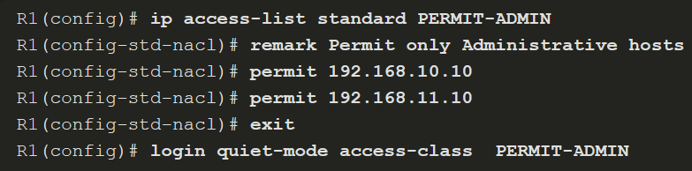
Configure Enhanced Security for Virtual Logins
Enable Login Enhancements
To help a Cisco IOS device provide DoS detection, use the login block-for command, which must be issued before any other login command. The login block-for command monitors login device activity and operates in two modes:
Normal mode - Also called watch mode, the router keeps count of the number of failed login attempts within an identified amount of time.
Quiet mode – Also called the quiet period. If the number of failed logins exceeds the configured threshold, all login attempts using Telnet, SSH, and HTTP are denied for the time specified in the login block-for command.
Notes:
4: Secure Device Access 4.3: Configure Enhanced Security for Virtual Logins 4.3.3: Enable Login Enhancements

Slide 19
Configure Enhanced Security for Virtual Logins
Log Failed Attempts
There are three commands that can be configured to help an administrator detect a password attack. Each lets a device to generate syslog messages for failed or successful login attempts. The first two commands, login on-success log and login on-failure log, generate syslog messages for successful and unsuccessful login attempts. An alternative to the login on-failure log command is the security authentication failure rate command can be configured to generate a log message when the login failure rate is exceeded.
Notes:
4: Secure Device Access 4.3: Configure Enhanced Security for Virtual Logins 4.3.4: Log Failed Attempts 4.3.5: Syntax Checker – Configure Enhanced Login Security on R2

Slide 20
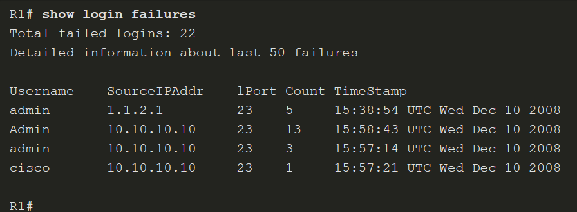
Configure Enhanced Security for Virtual Logins
Log Failed Attempts (Cont.)
Use the show login command to verify the login block-for command settings and current mode.
The show login failures command displays additional information regarding the failed attempts, such as the IP address from which the failed login attempts originated.
Notes:
4: Secure Device Access 4.3: Configure Enhanced Security for Virtual Logins 4.3.4: Log Failed Attempts 4.3.5: Syntax Checker – Configure Enhanced Login Security on R2

Slide 21
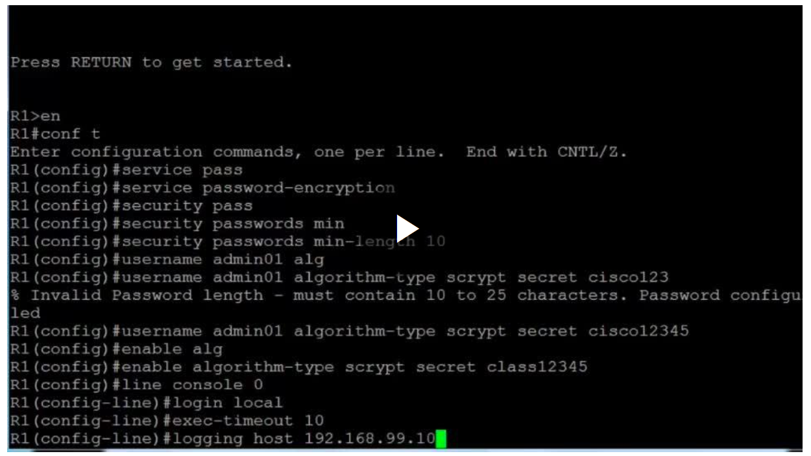
Configure Enhanced Security for Virtual Logins
Video – Configure Passwords and Enhanced Login
Notes:
4: Secure Device Access 4.3: Configure Enhanced Security for Virtual Logins
4.3.6 – Video – Configure Passwords and Enhanced Login Security

Slide 22
4.4 Configure SSH
Notes:
4: Secure Device Access 4.4: Configure SSH

Slide 23
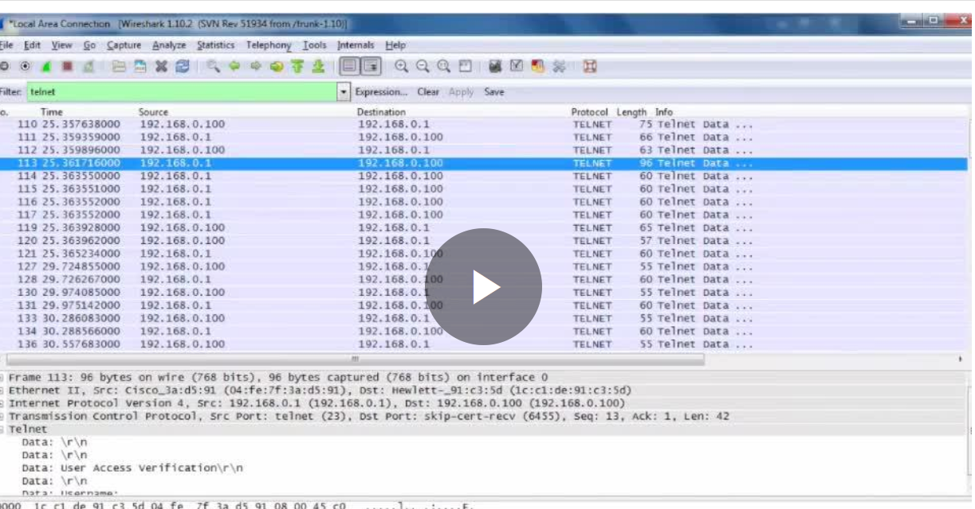
Configure SSH
Video – The Need for SSH
Notes:
4: Secure Device Access 4.4: Configure SSH 4.4.1: Video -The Need for SSH

Slide 24
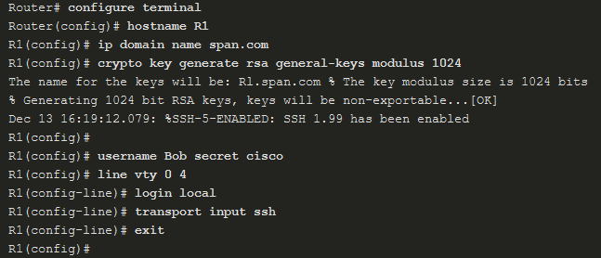
Configure SSH
Enable SSH
Configure a Cisco device to support SSH using the following six steps:
Step 1. Configure a unique device hostname.
Step 2. Configure the IP domain name.
Step 3. Generate a key to encrypt SSH traffic.
Step 4. Verify or create a local database entry.
Step 5. Authenticate against the local database.
Step 6. Enable vty inbound SSH sessions.
Notes:
4: Secure Device Access 4.4: Configure SSH 4.4.2: Enable SSH

Slide 25
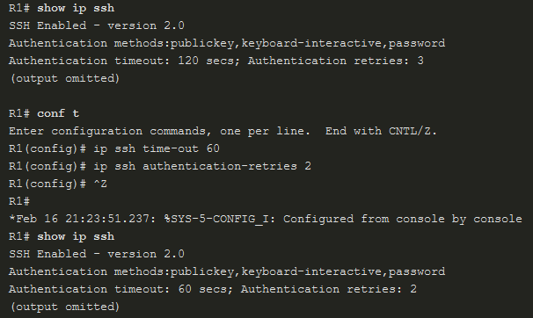
Configure SSH
Enhance SSH Login Security
To verify the optional SSH command settings, use the show ip ssh command. Use the ip ssh time-out seconds global configuration mode command to modify the default 120-second timeout interval. This configures the number of seconds that SSH can use to authenticate a user. By default, a user logging in has three attempts to enter the correct password before being disconnected. To configure a different number of consecutive SSH retries, use the ip ssh authentication-retries integer global configuration mode command.
Notes:
4: Secure Device Access 4.4: Configure SSH 4.4.3: Enhance SSH Login Security
4.4.4: Syntax Checker – Enable SSH on R2

Slide 26

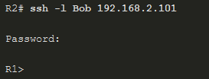
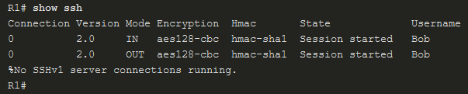
Configure SSH
Connect a Router to an SSH-Enabled Router
To verify the status of the client connections, use the show ssh command. There are two different ways to connect to an SSH-enabled router. By default, when SSH is enabled, a Cisco router can act as an SSH server or SSH client. As a server, a router can accept SSH client connections. As a client, a router can connect via SSH to another SSH-enabled router.
Check SSH Status
Connect from R2
To R1
View SSH Connections
Notes:
4: Secure Device Access 4.4: Configure SSH 4.4.5: Connect a Router to an SSH-Enabled Router

Slide 27
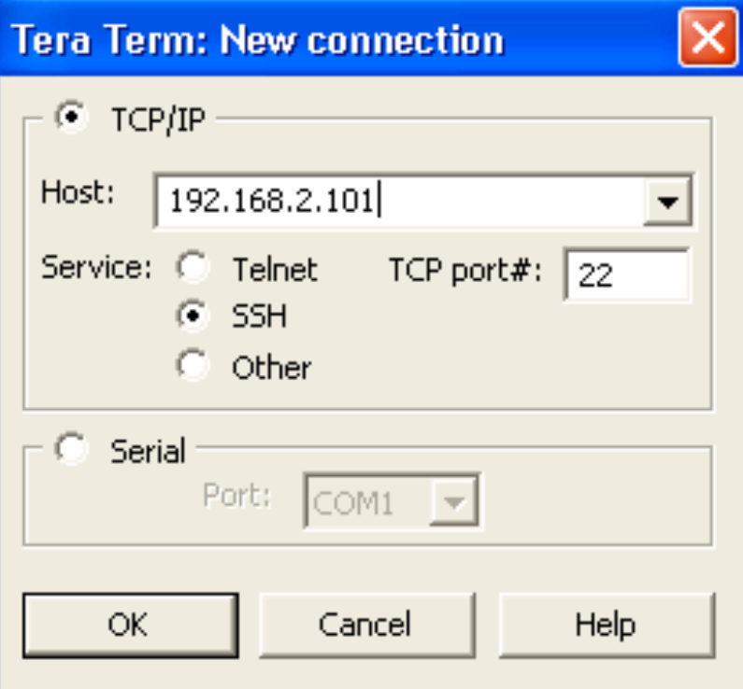
Configure SSH
Connect a Host to an SSH-Enabled Router
Connect using an SSH client (e.g., PuTTY, OpenSSH, TeraTerm) running on a host.
Generally, the SSH client initiates an SSH connection to the router. The router SSH service prompts for the correct username and password combination. After the login is verified, the router can be managed as if the administrator was using a standard Telnet session.
Notes:
4: Secure Device Access 4.4: Configure SSH 4.4.6: Connect a Host to an SSH-Enabled Router

Slide 28
Configure SSH
Lab - Configure Secure Administrative Access
In this lab, you will complete the following objectives:
Part 1: Configure Basic Device Settings
Part 2: Configure and Encrypt Passwords on Routers R1 and R3
Part 3: Configure Enhanced Username Password Security on Routers R1 and R3
Part 4: Configure the SSH Server on Routers R1 and R3
Notes:
4: Secure Device Access 4.4: Configure SSH 4.4.7: Lab - Configure Network Devices with SSH

Slide 29
Configure SSH
Packet Tracer - Configure Secure Passwords and SSH
The network administrator has asked you to prepare RTA and SW1 for deployment. Before they can be connected to the network, security measures must be enabled.
Notes:
4: Secure Device Access 4.4: Configure SSH 4.4.6: Packet Tracer - Configure Secure Passwords and SSH

Slide 30
Configure SSH
Lab - Configure Network Devices with SSH
In this lab, you will complete the following objectives:
Part 1: Configure Basic Device Settings
Part 2: Configure the Router for SSH Access
Part 3: Configure the Switch for SSH Access
Part 4: SSH from the CLI on the Switch
Notes:
4: Secure Device Access 4.4: Configure SSH 4.4.7: Lab - Configure Network Devices with SSH

